Slide 1
Data Presentation
Jiejun

Slide 2
Problem Background
ShopEasy, an online retail business, is facing reduced customer engagement and conversion rates despite launching several new online marketing campaigns.
Key Points:
  Reduced Customer Engagement: The number of customer interactions and engagement with the site and marketing content has declined.
  Decreased Conversion Rates: Fewer site visitors are converting into paying customers.
  High Marketing Expenses: Significant investments in marketing campaigns are not yielding expected returns.
  Need for Customer Feedback Analysis: Understanding customer opinions about products and services is crucial for improving engagement and conversions.

Slide 3
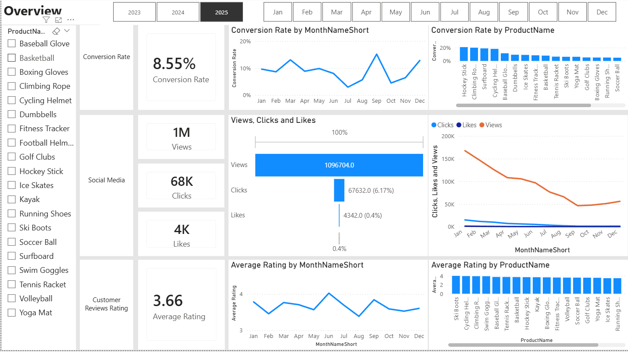
Overview
Decreased Conversion Rates: The conversion rate remained relatively stable in the first half of the year at around 10%, followed by a noticeable decline in July and August. September shows a sharp, short-term spike, likely driven by a specific campaign or promotional activity, as the rate quickly returned to baseline in October. A further investigation should be implemented in July and October
Reduced Customer Engagement:
  There is a decline in overall social media engagement, with views dropping throughout the year.
  While clicks and likes are low compared to views, the click-through rate stands at 6.17%, meaning that engaged users are still interacting effectively based on E-commerce knowledge.
Customer Feedback Analysis:
  Customer ratings have remained consistent, averaging around 3.66 throughout the year.
  Although stable, the average rating is below the target of 4.0, suggesting a need for focused improvements in customer satisfaction, for products below 3,5.

Slide 4
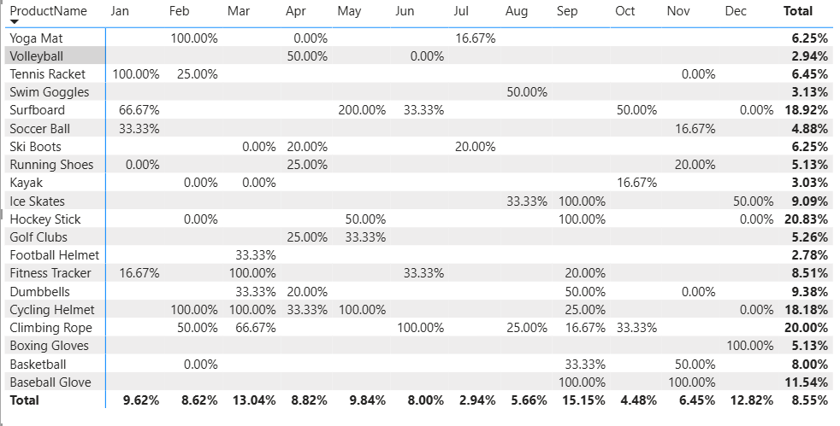
Decreased Conversion Rates
General Conversion Trend:
  Conversion performance fluctuated throughout the year, with noticeable peaks in March and September, where a broader range of products achieved relatively strong conversion rates.
  In contrast, July and October recorded weaker overall performance (2.94% and 4.48% respectively). This decline appears to be associated with narrower promotional coverage and lower transaction volume
High-Performing Product Categories:
  In peak months such as March and September, several products consistently demonstrated stronger conversion performance, including: Fitness Tracker, Dumbbells, Cycling Helmet and climbing Robe. However, in July and October, these categories either received limited campaign support or experienced reduced traffic contribution, which may have constrained their overall impact on monthly performance.

Slide 5
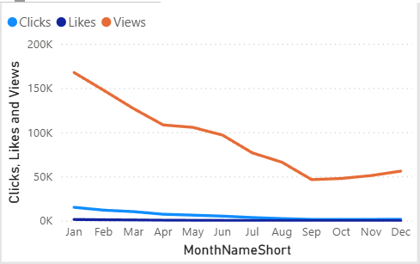
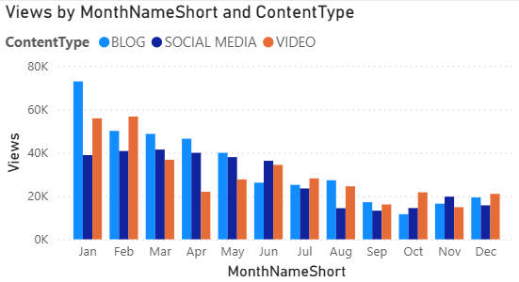
Reduced Customer Engagement
Declining Views and low interaction:
  Views have a consistent decline until September, then remain stable. Clicks and likes remained consistently low compared to views, suggesting the need for more engaging content or stronger calls to action
Content Type Performance:
  Traffic across all content types peaked in Q1 and gradually declined toward mid-year before partially Traffic across all content types peaked in Q1 and gradually declined toward mid-year before partially recovering in Q4. Blog content drives the highest volume but is also the most volatile, while social media traffic appears relatively stable throughout the year. The mid-year traffic decline likely contributed to the overall drop in conversion performance during July and August.

Slide 6
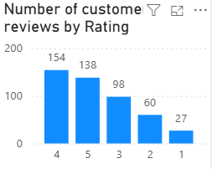
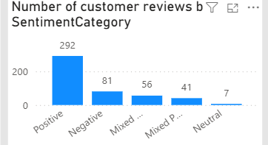
Customer Feedback Analysis
Customer Ratings Distribution:
  The majority of customer reviews are in the higher ratings, with 154 reviews at 4 stars and 138 reviews at 5 stars, indicating overall positive feedback. Lower ratings (1-2 stars) account for a smaller proportion, with 27 reviews at 1 star and 60 reviews at 2 stars.
Sentiment Analysis:
  Positive sentiment dominates with 292 reviews, reflecting a generally satisfied customer base. Negative sentiment is present in 12 reviews, with a smaller number of mixed and neutral sentiments, suggesting some areas for improvement but overall strong customer approval.
Opportunity for Improvement:
  The presence of mixed positive and mixed negative sentiments suggests that there are opportunities to convert those mixed experiences into more clearly positive ones, potentially boosting overall ratings. Addressing the specific concerns in mixed reviews could elevate customer satisfaction.

Slide 7
Goals
Actions
Increase Conversion Rates:
  Goal: Identify factors impacting the conversion rate and provide recommendations to improve it.
  Insight: Highlight key stages where visitors drop off and suggest improvements to optimize the conversion funnel.
Enhance Customer Engagement:
  Goal: Determine which types of content drive the highest engagement.
  Insight: Analyze interaction levels with different types of marketing content to inform better content strategies.
Improve Customer Feedback Scores:
  Goal: Understand common themes in customer reviews and provide actionable insights.
  Insight: Identify recurring positive and negative feedback to guide product and service improvements.
Increase Conversion Rates:
  Target High-Performing Product Categories: Focus marketing efforts on products with demonstrated high conversion rates, such as Surfboard, Hockey Stick, Cycling Helmet and climbing rope. Implement seasonal promotions or personalized campaigns during peak months (e.g., March and September) to capitalize on these trends.
  In weak performance month, 2 strategies can be considered.
  1. Growth-Oriented Strategy: If the company aims to gain market share and strengthen competitive positioning, launching targeted campaigns for historically high-performing products may help stimulate demand and capture incremental growth during slower periods.
  2. Cost-Control Strategy: If the priority is profitability and risk management, reducing overall marketing spend during low-demand months may help control costs and protect margins, particularly when traffic volume and conversion stability are limited.
Enhance Customer Engagement:
  Revitalize Content Strategy: To turn around declining views and low interaction rates, experiment with more engaging content formats, such as interactive videos or user-generated content. Additionally, boost engagement by optimizing call-to-action placement in social media and blog content, particularly during historically lower-engagement months (July to September).
Improve Customer Feedback Scores:
  Address Mixed and Negative Feedback: Implement a feedback loop where mixed and negative reviews are analyzed to identify common issues. Develop improvement plans to address these concerns. Consider following up with dissatisfied customers to resolve issues and encourage re-rating, aiming to move average ratings closer to the 4.0 target.

